Slide 1
Chapter 18
Testing Conventional Applications
Slide Set to accompany
Software Engineering: A Practitioner’s Approach, 7/e
by Roger S. Pressman
Slides copyright © 1996, 2001, 2005, 2009 by Roger S. Pressman
For non-profit educational use only
May be reproduced ONLY for student use at the university level when used in conjunction with Software Engineering: A Practitioner's Approach, 7/e. Any other reproduction or use is prohibited without the express written permission of the author.
All copyright information MUST appear if these slides are posted on a website for student use.
These slides are designed to accompany Software Engineering: A Practitioner’s Approach, 7/e (McGraw-Hill, 2009) Slides copyright 2009 by Roger Pressman.

Slide 2
Testability
Software testability is simply how easily [a computer program] can be tested.
Operability
Observability
Controllability
Decomposability.
Simplicity.
Stability.
Understandability.
These slides are designed to accompany Software Engineering: A Practitioner’s Approach, 7/e (McGraw-Hill, 2009) Slides copyright 2009 by Roger Pressman.

Slide 3
White-box testing
Using white-box testing methods, you can derive test cases that
(1) guarantee that all independent paths within a module have been exercised at least once,
(2) exercise all logical decisions on their true and false sides,
(3) execute all loops at their boundaries and within their operational bounds, and
(4) exercise internal data structures to ensure their validity.
These slides are designed to accompany Software Engineering: A Practitioner’s Approach, 7/e (McGraw-Hill, 2009) Slides copyright 2009 by Roger Pressman.

Slide 4
Basis path testing
The basis path method enables the test-case designer to derive a logical complexity measure of a procedural design and use this measure as a guide for defining a basis set of execution paths.
Cyclomatic Complexity
These slides are designed to accompany Software Engineering: A Practitioner’s Approach, 7/e (McGraw-Hill, 2009) Slides copyright 2009 by Roger Pressman.

Slide 5
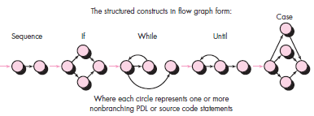
Flow graph
Each structured construct has a corresponding flow graph symbol.
These slides are designed to accompany Software Engineering: A Practitioner’s Approach, 7/e (McGraw-Hill, 2009) Slides copyright 2009 by Roger Pressman.

Slide 6

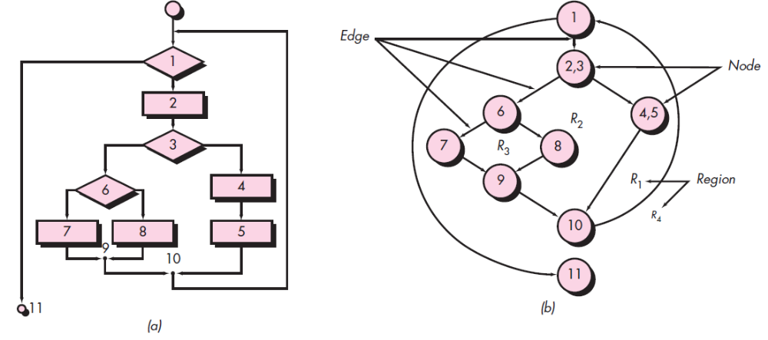
(a) Flowchart and (b) flow graph
These slides are designed to accompany Software Engineering: A Practitioner’s Approach, 7/e (McGraw-Hill, 2009) Slides copyright 2009 by Roger Pressman.

Slide 7
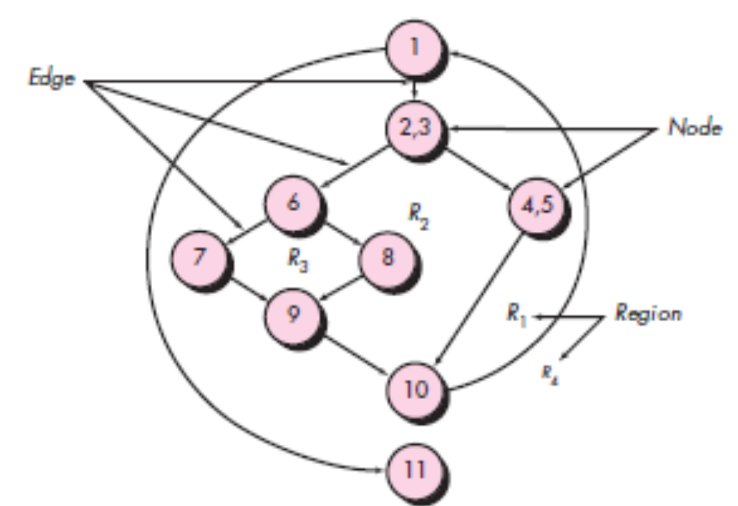
Independent Program Paths
Path 1: 1-11
Path 2: 1-2-3-4-5-10-1-11
Path 3: 1-2-3-6-8-9-10-1-11
Path 4: 1-2-3-6-7-9-10-1-11
Note that each new path introduces a new edge. The path
1-2-3-4-5-10-1-2-3-6-8-9-10-1-11
is not considered to be an independent path because it is simply a combination of already specified paths and does not traverse any new edges.
How do you know how many paths to look for? The computation of cyclomatic complexity provides the answer.
These slides are designed to accompany Software Engineering: A Practitioner’s Approach, 7/e (McGraw-Hill, 2009) Slides copyright 2009 by Roger Pressman.

Slide 8
Cyclomatic complexity
Cyclomatic complexity is a software metric that provides a quantitative measure of the logical complexity of a program.
Complexity is computed in one of three ways:
The number of regions of the flow graph corresponds to the cyclomatic complexity. (in the previous example = 4)
Cyclomatic complexity V(G) for a flow graph G is defined as V(G) = E - N + 2 (in the previous example 11 -9 + 2 = 4)
  where E is the number of flow graph edges and N is the number of flow graph nodes.
Cyclomatic complexity V(G) for a flow graph G is also defined as V(G) = P + 1 (in the previous example 3 + 1 = 4)
  where P is the number of predicate nodes contained in the flow graph G.
These slides are designed to accompany Software Engineering: A Practitioner’s Approach, 7/e (McGraw-Hill, 2009) Slides copyright 2009 by Roger Pressman.

Slide 9
Black-box testing
Focuses on the functional requirements of the software.
Black-box testing attempts to find errors in the following categories:
(1) incorrect or missing functions,
(2) interface errors,
(3) errors in data structures or external database access,
(4) behavior or performance errors, and
(5) initialization and termination errors.
These slides are designed to accompany Software Engineering: A Practitioner’s Approach, 7/e (McGraw-Hill, 2009) Slides copyright 2009 by Roger Pressman.

